Slide 1
Retail Sales Forecast - Timeseries Analysis
“Global Mart” is an online store super giant having worldwide operations. It takes orders and delivers across the globe and deals with all the major product categories - consumer, corporate & home office.
As an operations manager, we need to finalise the plan for the next 6 months by forecasting the sales and the demand for the period, so that revenue and inventory can be managed accordingly.
We have considered TOP 5 segments for analysis based on Profit and Profitability Index are-
# APAC Consumer : 222k ; 63
# EU Consumer : 188k ; 62.4
# APAC Corporate: 129k ; 69
# EU Corporate : 123k ; 76
# LATAM Consumer: 120k ; 66
Findings: If we compare Manual decomposition based model with AUTOARIMA models, we could see that Manual Models have performed better compared to AUTOARIMA models

Slide 2
Methodology
Plot ACF and PACF on the train dataset
Compute Auto-ARIMA on the dataset
Compute MAPE value for regression and ARIMA model out of sample data
Start
Store latest 6 months data as Test dataset and rest months as Train
Manually decompose the trend by smoothening the curve
Make Subsets based on Market and Segment
Compute optimal value of p,d,q for ARIMA modelling
Aggregate data to month level based on Sales, profit and Quantity
These 5 profitable segments will be analysed further
Try to fit it with the regression line
Decide which model is better AUTO-ARIMA vs Manual
Take the Trend out of the Time Series leaves us with the residue
Check Auto-ARIMA vs Manual decomposition based on AIC,AICC, BIC
Calculate Profitability Index for each aggregated subset
Identify the Top-5 Profitable segments

Slide 3
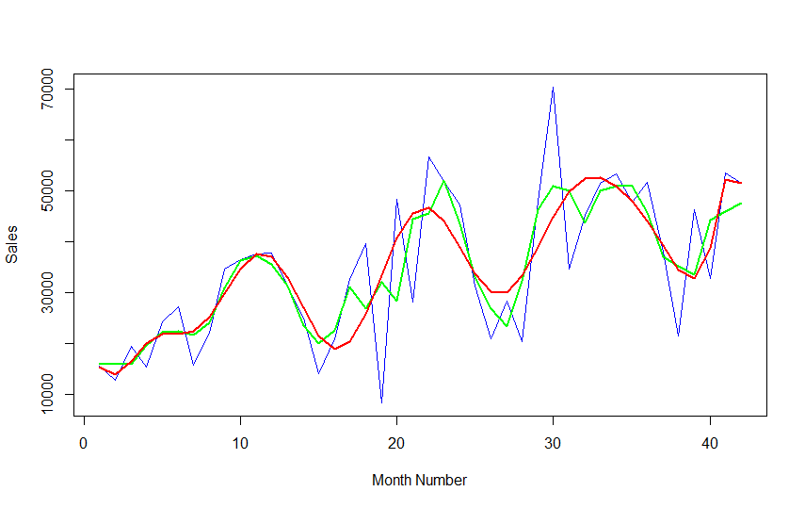
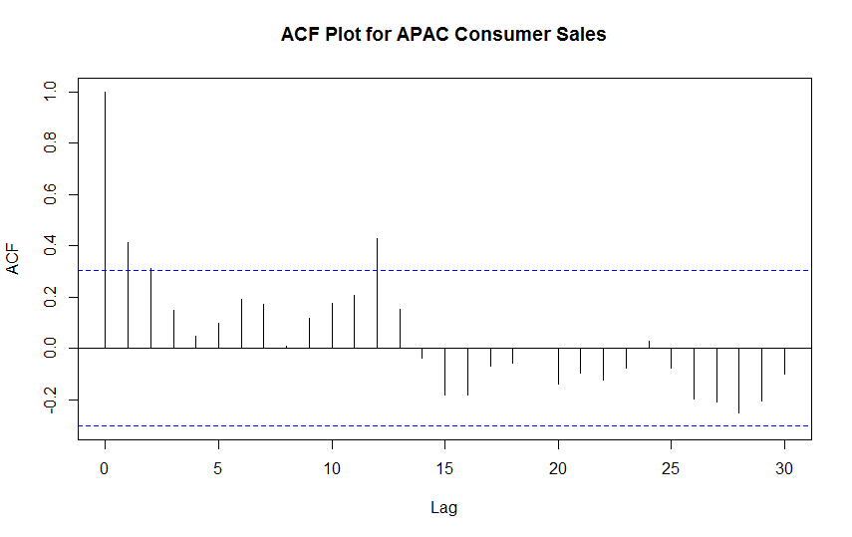
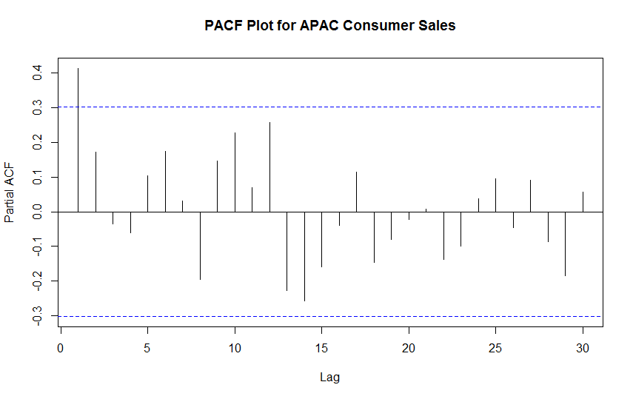
Sales - CONSUMER Segment - APAC marketplace
Original Dataset Plot
Smoothened plot
Linear Regression Fit
Result Set MAPE for Regression : 27.48488
MAPE for autoarima : 27.68952

Slide 4
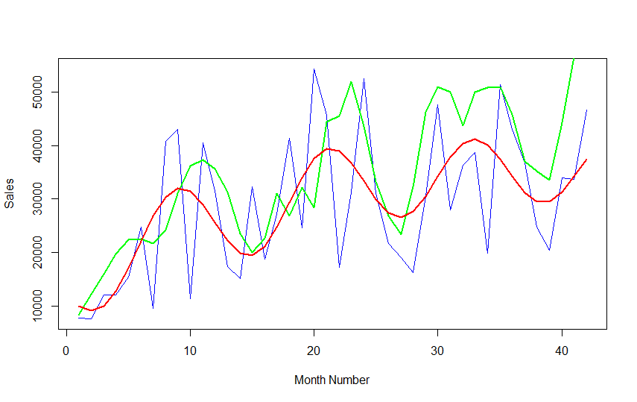
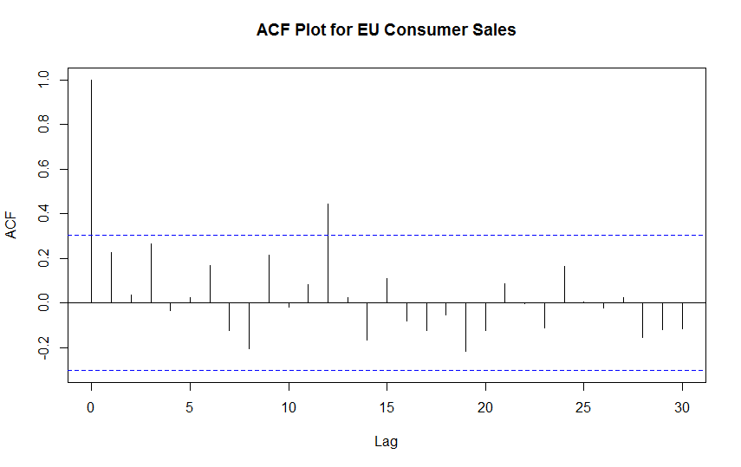
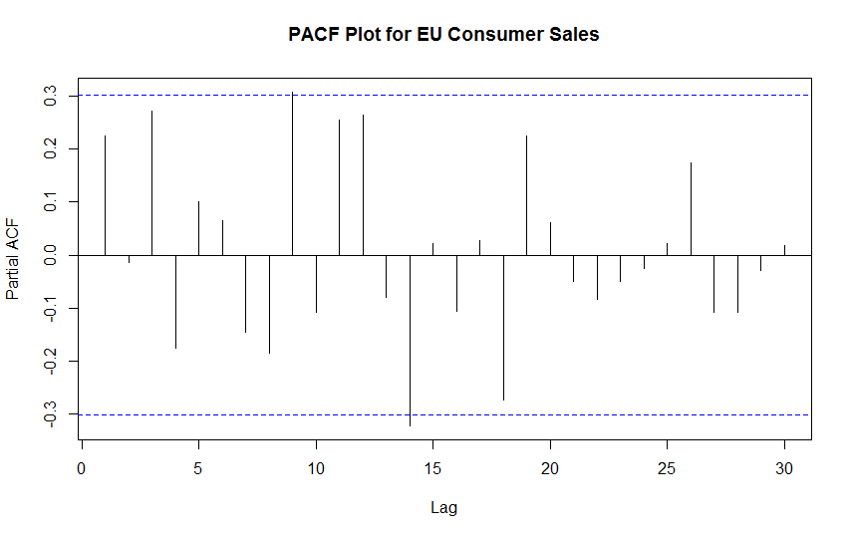
Sales - CONSUMER Segment - EU marketplace
Result Set MAPE for Regression : 22.71581
MAPE for autoarima : 28.9226
Original Dataset Plot
Smoothened plot
Linear Regression Fit

Slide 5
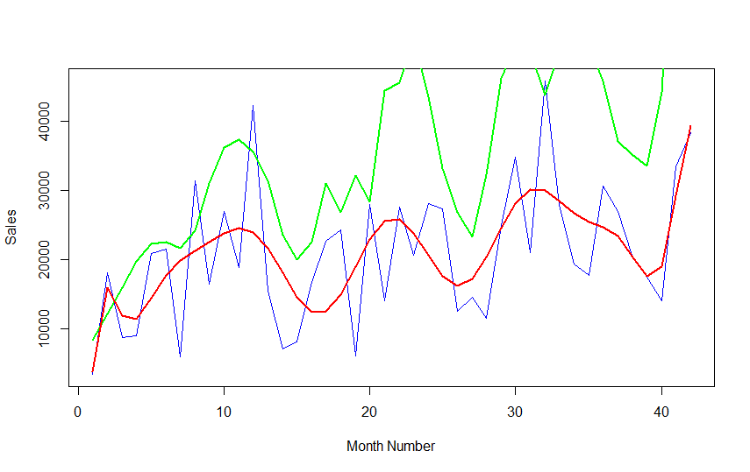
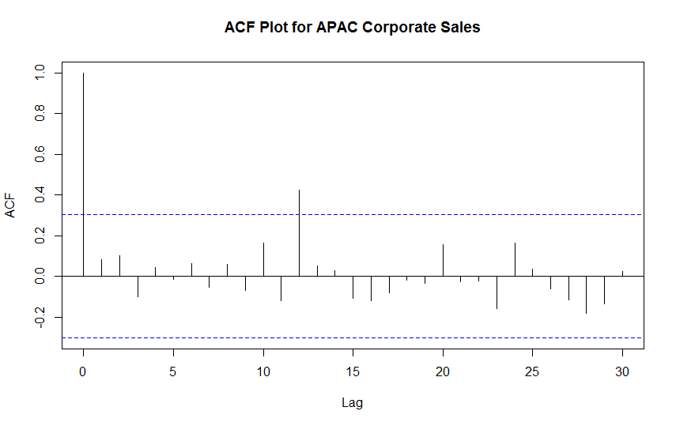
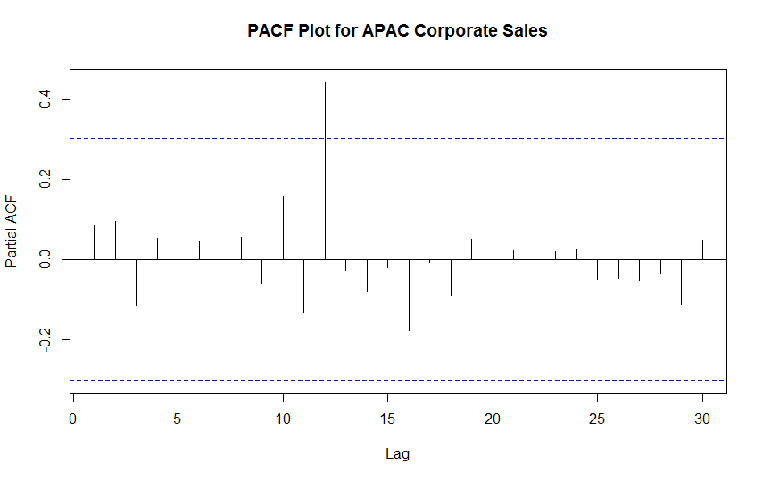
Sales - CORPORATE Segment - APAC marketplace
Result Set MAPE for Regression : 26.55771
MAPE for autoarima : 27.97408
Original Dataset Plot
Smoothened plot
Linear Regression Fit

Slide 6
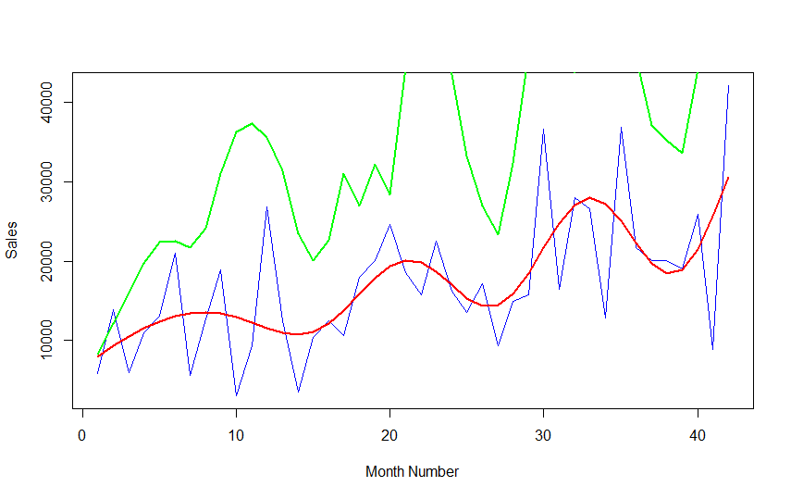
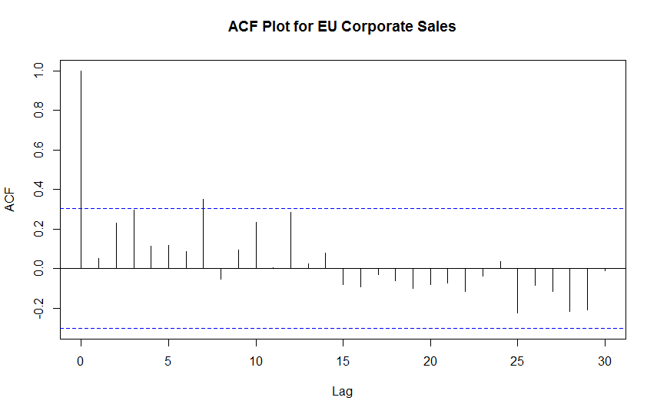
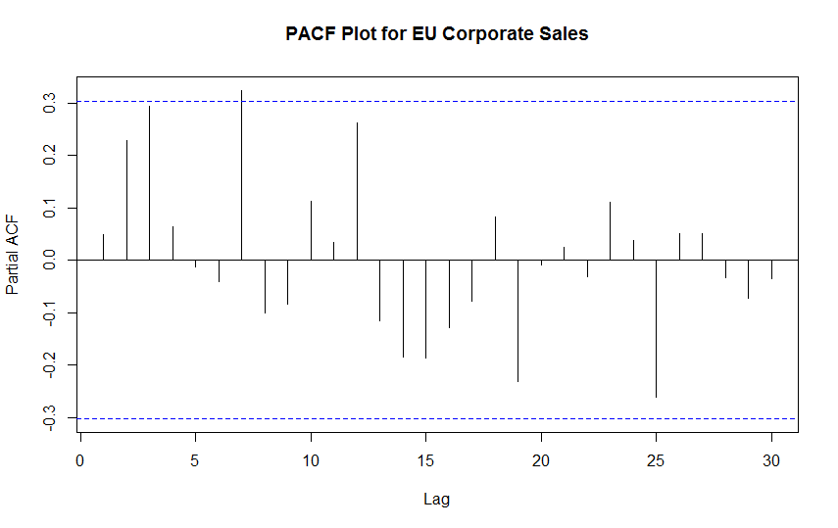
Sales - CORPORATE Segment - EU marketplace
Result Set MAPE for Regression : 79.79463
MAPE for autoarima : 36.35092
Original Dataset Plot
Smoothened plot
Linear Regression Fit

Slide 7
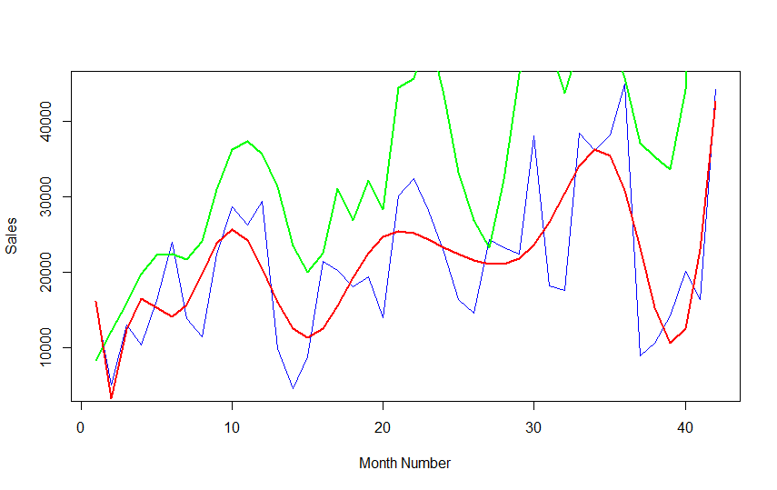
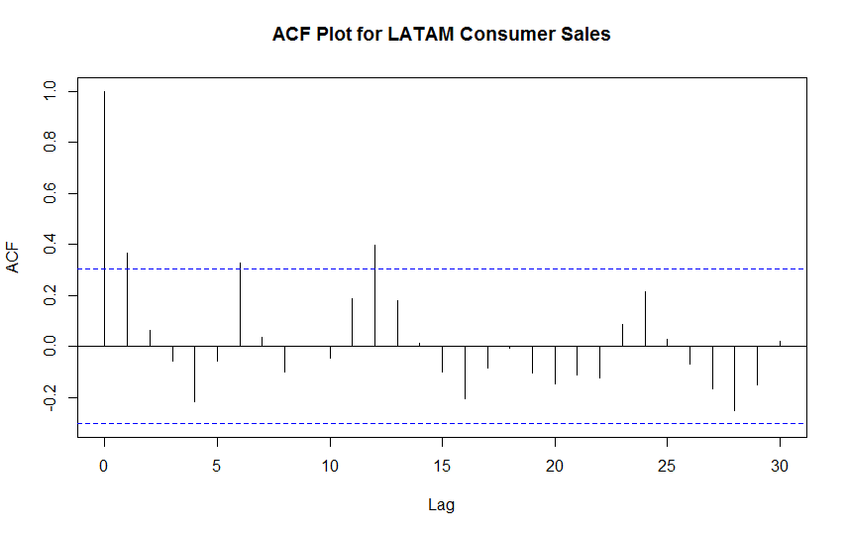
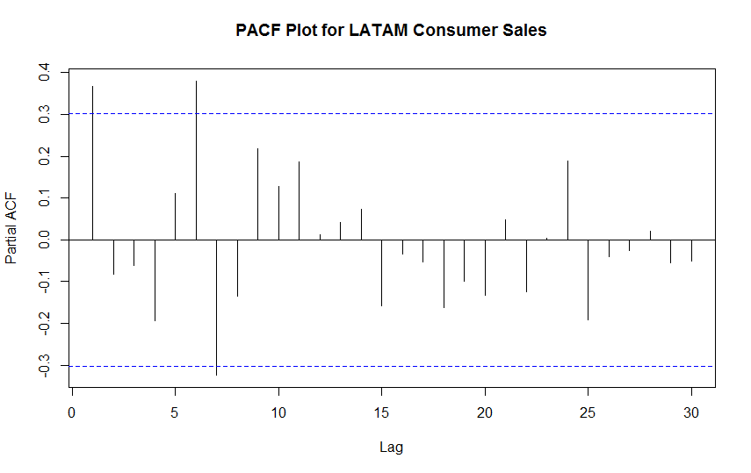
Sales - CONSUMER Segment - LATAM marketplace
Result Set MAPE for Regression : 31.66988
MAPE for autoarima : 33.96611
Original Dataset Plot
Smoothened plot
Linear Regression Fit

Slide 8
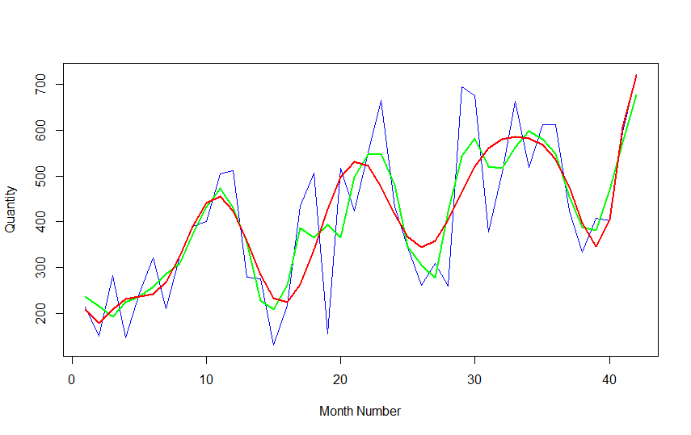
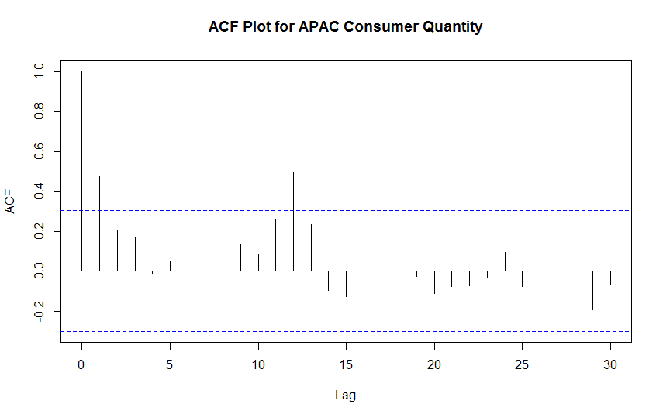
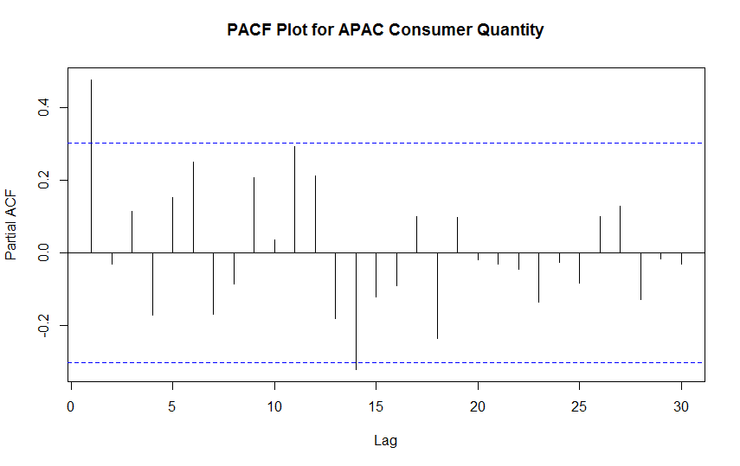
Quantity - CONSUMER Segment - APAC marketplace
Result Set MAPE for Regression : 37.13402
MAPE for autoarima : 26.24458
Original Dataset Plot
Smoothened plot
Linear Regression Fit

Slide 9
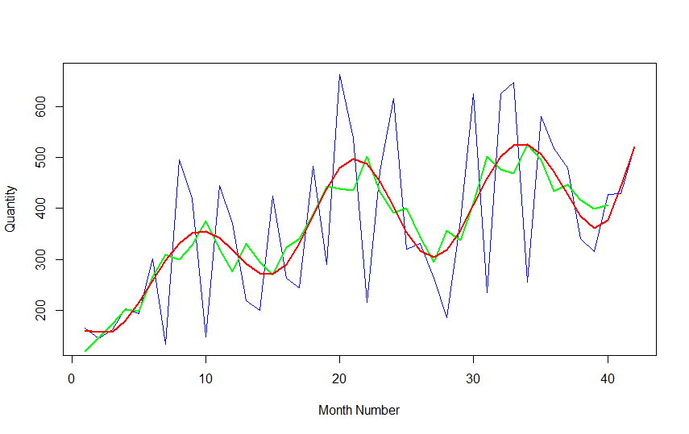
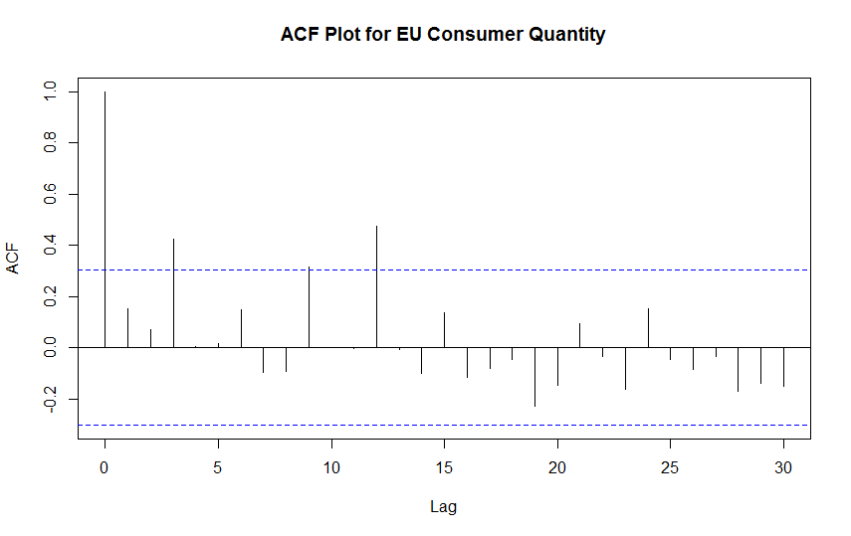
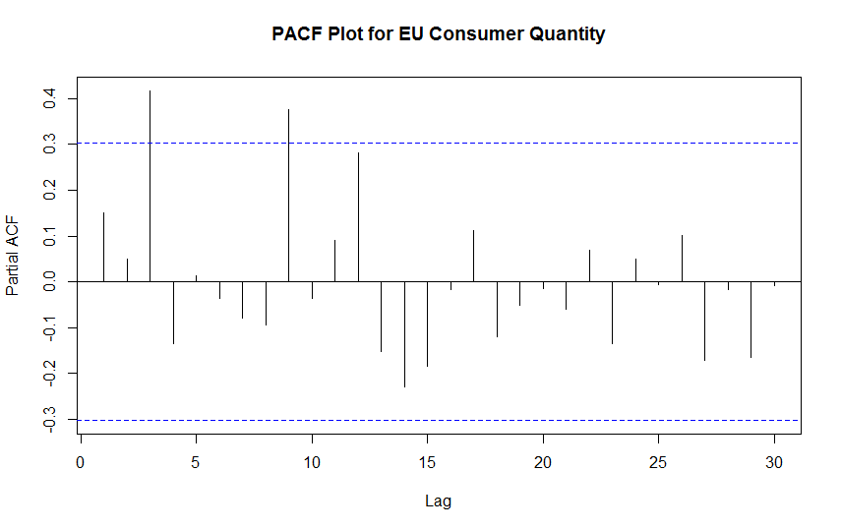
Quantity - CONSUMER Segment - EU marketplace
Result Set MAPE for Regression : 29.37811
MAPE for autoarima : 30.13319
Original Dataset Plot
Smoothened plot
Linear Regression Fit

Slide 10
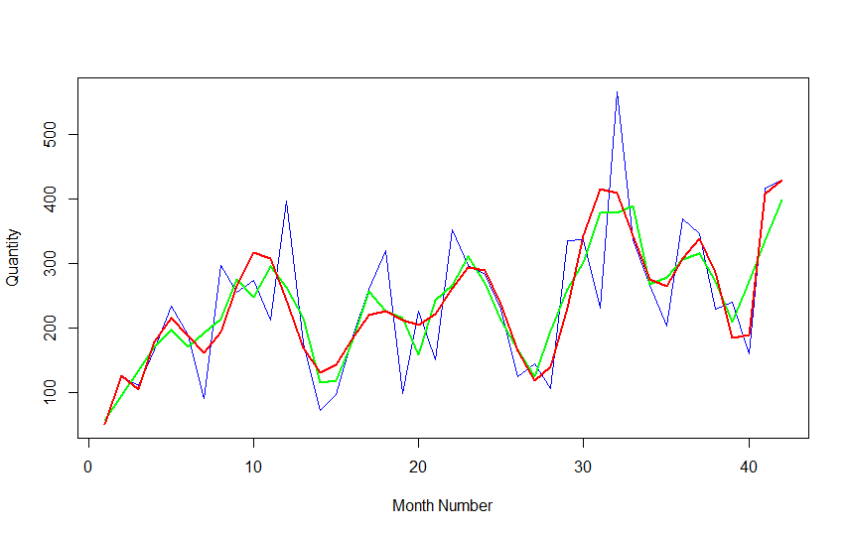
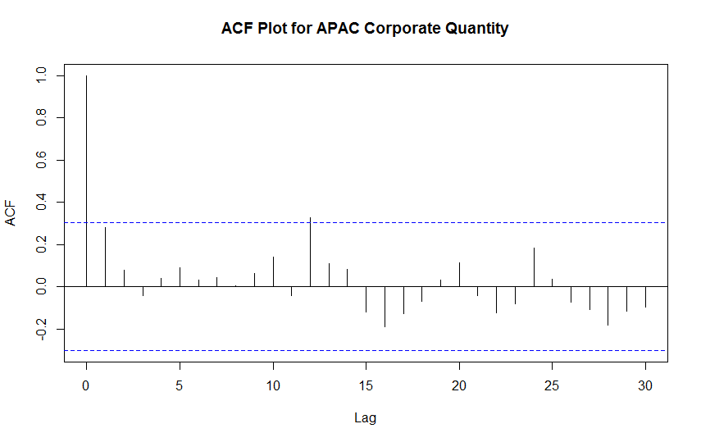
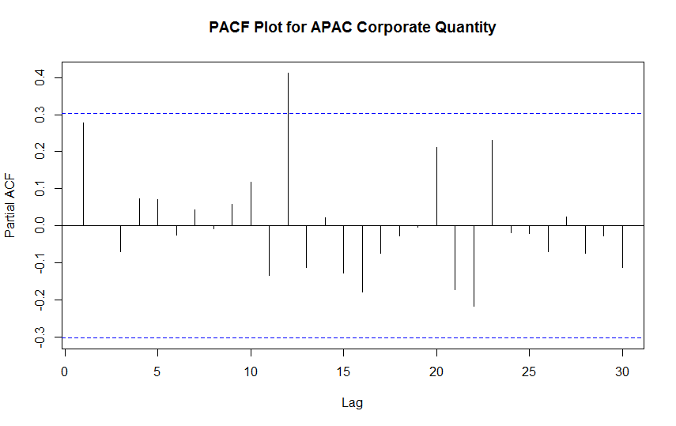
Quantity - CORPORATE Segment - APAC marketplace
Result Set MAPE for Regression : 27.67883
MAPE for autoarima : 24.13219
Original Dataset Plot
Smoothened plot
Linear Regression Fit

Slide 11
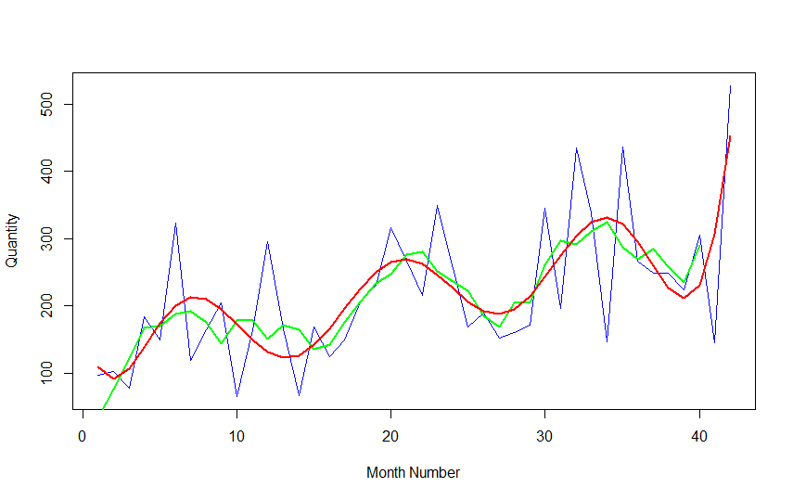
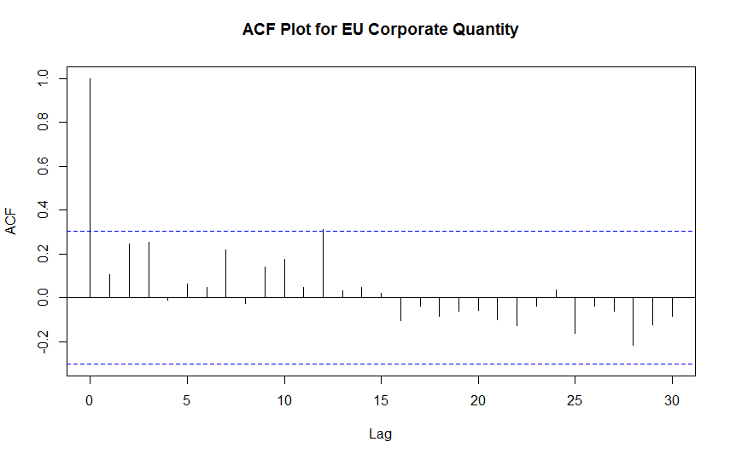
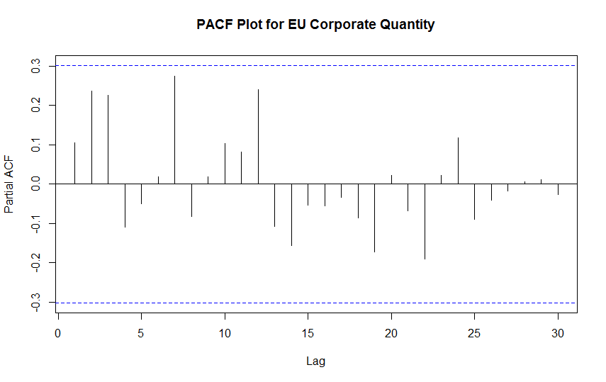
Quantity - CORPORATE Segment - EU marketplace
Result Set MAPE for Regression : 197.4539
MAPE for autoarima : 47.54968
Original Dataset Plot
Smoothened plot
Linear Regression Fit

Slide 12
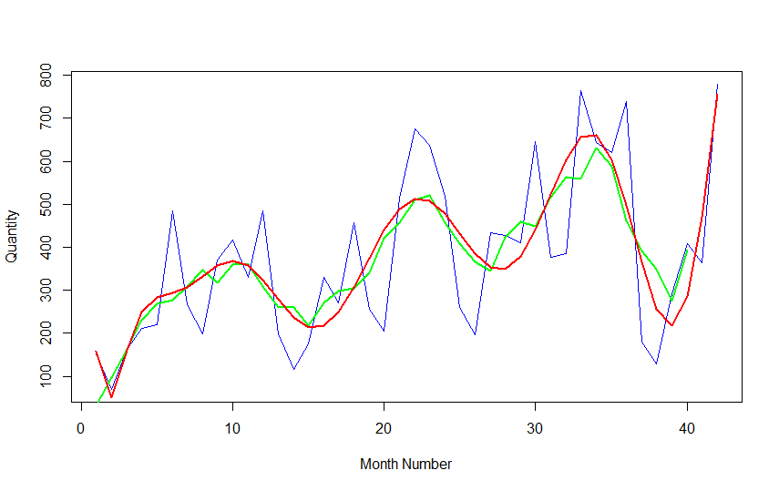
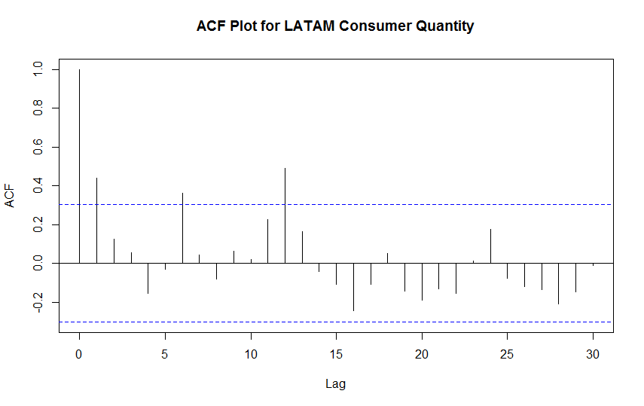
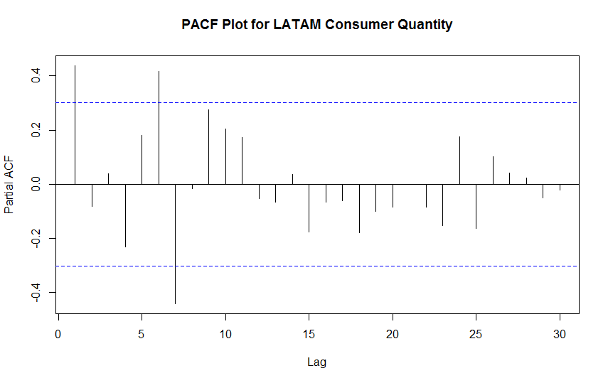
Quantity - Consumer Segment - LATAM marketplace
Result Set MAPE for Regression : 123.57532
MAPE for autoarima : 47.69576
Original Dataset Plot
Smoothened plot
Linear Regression Fit

